Slide 1
EEE 1131: Electrical Circuits
Prepared By :
Md. Rezaur Raihan
Assistant Professor
Department of Electrical and Electronic Engineering
Khulna University of Engineering & Technology

Slide 2
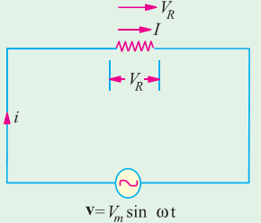
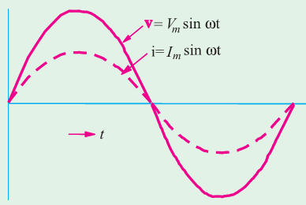
A.C. Through Pure Ohmic Resistance Alone

Slide 3
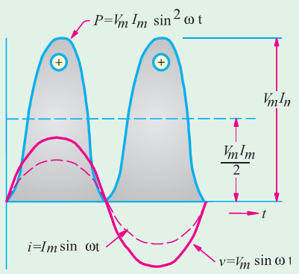
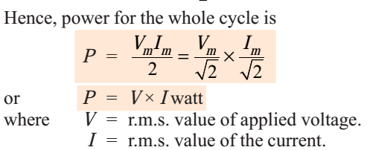
A.C. Through Pure Ohmic Resistance Alone

Slide 4
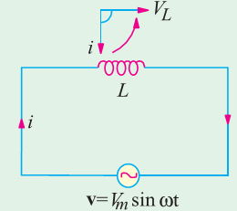
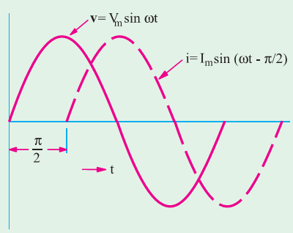
A.C. Through Pure Inductance Alone

Slide 5
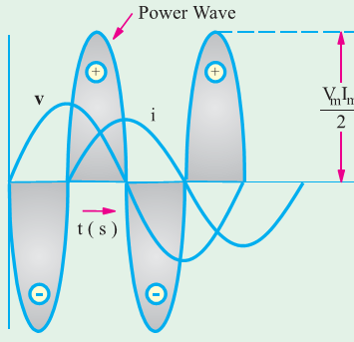
A.C. Through Pure Inductance Alone

Slide 6
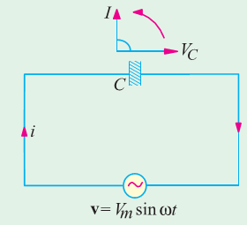
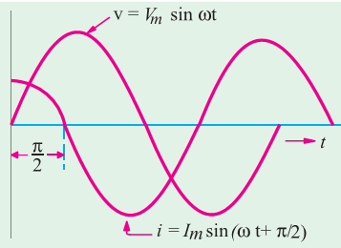
A.C. Through Pure Capacitance Alone

Slide 7
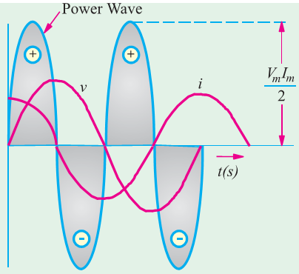
A.C. Through Pure Capacitance Alone

Slide 8
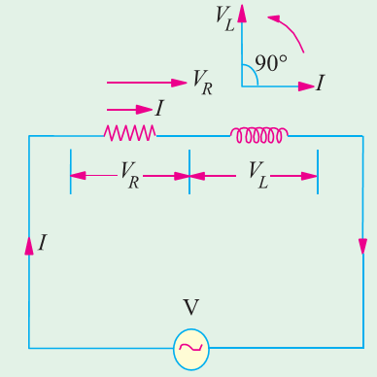
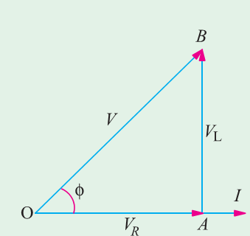
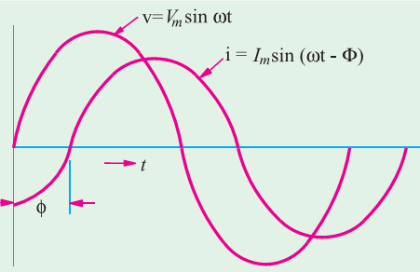
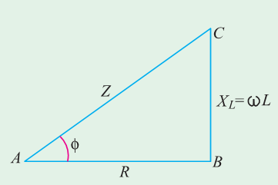
A.C. Through Resistance and Inductance

Slide 9
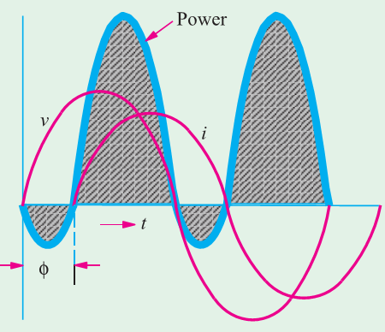
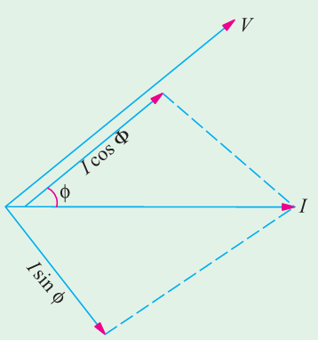
A.C. Through Resistance and Inductance

Slide 10
A.C. Through Resistance and Inductance
Remember that in an a.c. circuit, the product of r.m.s. volts and r.m.s. amperes gives voltamperes (VA) and not true power in watts. True power (W) = volt-amperes (VA) × power factor.

Slide 11
A.C. Through Resistance and Inductance

Slide 12
A.C. Through Resistance and Inductance

Slide 13
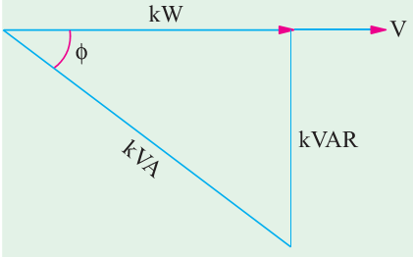
Active and Reactive Components of Circuit Current I

Slide 14
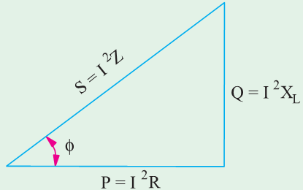
Active, Reactive and Apparent Power

Slide 15
Thank YOU

